Slide 1
Unit - iv
Cost & Investment Analysis

Slide 2
4.2 ict revolution & cost
The recent revolution in information and communication technology (ICT) has important implications for the way firms work and for the economy in general.

Slide 3
New Technology
The revolution in information and communication technologies (ICT) has roots that go back to the nineteenth century, but it accelerated in the latter part of the twentieth century when a new general purpose built technology, the electronic computer and a few related technologies, began to transform much of the economic, social, and political structure of society.
The revolution has been associated with many new products, new production processes, and new forms of organization.

Slide 4
Falling cost curves
Most of the firms are assumed to have U-shaped cost curves
However many ICT firms are working with cost curves that decline over their whole range
Typically, there are very large fixed costs associated with the R&D and set up costs of creating a new technology in the ICT sector
In contrast, MC of producing another unit of output are very small or virtually zero
As a result, the AC declines throughout its whole relevant range
Example – Microsoft windows operating system, telephone lines, Optic fiber cables

Slide 5
Two of the special features of ICT industries are increasing returns and network externalities. These generate a winner-take-all competition between firms.
As new entrants find it virtually impossible to break in to an industry where the established player is selling its product at very low marginal cost
This is further reinforced by the network externalities that arises from the adoption of common standards
Example – Windows based software, Facebook, WhatsApp

Slide 6
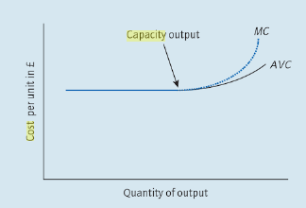
The nature of competition is different in constant or falling MC industries

Slide 7
Where costs are rising, firms are competing at the margin - A small price change or quality initiative will take a bit of business at the margin from several main rivals
However, constant or falling MC industries tend to have big jumps from one dominant player to another
Companies like Intel, Microsoft, Amazon, Google grew to be huge within less than two decades
They may disappear just as quickly if some new and better technology removes their edge
Example – BlackBerry phones, Nokia

Slide 8
In contrast, traditional retailers, banks and manufacturers tend to grow up slowly and fade slowly
They may merge or to be taken over and so lose their name, but they are rarely made redundant by the sudden appearance of new technology
Example – KODAK Films

Slide 9
Break even analysis
Since profit-earning is one of the most important objectives of any company, profit cannot be left to chance or luck
Break even analysis in the major technique applied for profit-planning
A break even analysis indicates at what level cost and revenue are in equilibrium
Break even point –
A point where TR=TC – It is a point of zero profit
Break even chart -
It shows the extent of loss or profit to the firm at different levels of the activity

Slide 10
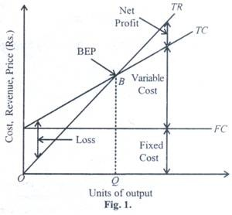
Break even chart

Slide 11
It is possible to calculate the break-even output if a firm knows the value of its fixed costs, variable costs and the price it will charge. The simplest way to calculate the break-even output is
to use contribution.
The following formula can be used:
Break-even output = Fixed costs / Contribution per unit

Slide 12
Review question
The product is sold for £10 per unit. The variable cost per unit is £4. Fixed costs are £40,000 (the same at each level of output).
Break-even output (units) = Fixed costs (£) / Contribution per unit (£)
So, break-even output = £40,000 divided by £6 = 6,666 units

Slide 13
Break-even Analysis & pricing strategies
Penetration pricing – ‘high’ volume, ‘low’ price – more sales to break even
Market Skimming – ‘high’ price, ‘low’ volumes – fewer sales to break even
Elasticity – What is likely to happen to sales when prices are increased or decreased?

Slide 14
example
A business produces 1,000 units and sells them for £50 each. Total fixed costs are £10,000. Variable costs are £40 per unit.
So total variable costs are £40 × 1,000 = £40,000
Therefore:
Total costs = £10,000 + £40,000 = £50,000
Total revenue = £50 × 1,000 = £50,000
Total revenue and total costs are exactly the same at £50,000.
Therefore the business will break even at this level of output. So the break-even output is 1,000 units.

Slide 15
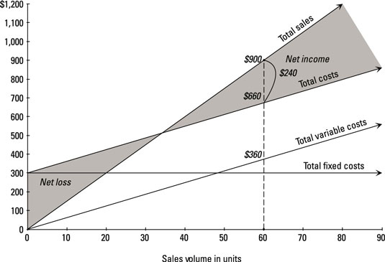
Contribution margin
Contribution margin is the difference between TR-TVC
"Contribution" represents the portion of sales revenue that is not consumed by variable costs and so contributes to the coverage of fixed costs.

Slide 16
Review question
Craig Eckert sells second-hand cars. His last sale was £990 for a Golf GTI. He bought the Golf at a car auction for £890. The difference between what he paid for the car and the price he sold it for is £100 (£990 – £890).
This difference is called the contribution. It is not profit because Craig has fixed costs to pay such as rent, insurance and administration expenses. Contribution is the difference between selling price and variable costs. In this case the selling price was £990 and the variable cost was £890. The £100 will contribute to the total fixed costs of the business and the profit.

Slide 17
Contribution per unit and total contribution
Total contribution - When more than one unit is sold the total contribution can be calculated.
For example, a textile company receives an order for 1,000 pairs of trousers. The variable costs are £7.50 a pair and they will be sold for £9.00 a pair. The total contribution made by the order is
Total contribution = total revenue - total variable cost
= (£9.00 × 1,000) – (£7.50 × 1,000)
= £9,000 – £7,500
= £1,500

Slide 18
Margin of safety
What if a business is producing more than the break-even output? It might be useful to know by how much sales could fall before a loss is made. This is called the Margin of safety.
It refers to the range of output over which a profit can be made.
The margin of safety can be identified on the break-even chart by measuring the distance between the break-even level of output and the current (profitable) level output.

Slide 19
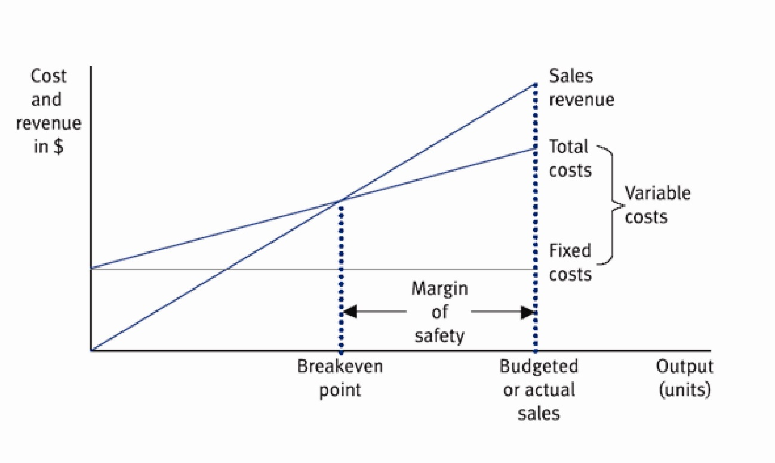

Slide 20
example
Margin = Current sales – Breakeven Point / Current sales x 100
If Jack currently produces 1,200 benches the margin of safety is 200 benches. (assuming break even at 1000)
This means that output can fall by 200 before a loss is made.

Slide 21
Assumptions
Cost can be classified into fixed, variable and semi-variable
Sale price is constant
Constant rate of increase in variable cost
No improvement in technology & labour efficiency
No change in input price
Production and sales are synchronized

Slide 22
Uses
Helps in determining the level of optimum output
Determining the target capacity for a firm to get the benefit of minimum cost of production
Which products to be produced can be decided ?
Decisions on plant expansion or contraction ?
Impact of change in price and cost can be analyzed
Appropriate selling price can be find out
Firm can decide when to pay dividend

Slide 23
Limitations
Input price keep on changing
Product price also changes
Static in nature – Assume constant relationship of output to costs and revenue
Profit not only depends on output but also on other factors like technological improvements, managerial efficiency etc.
BEP ignores selling cost and concentrate production costs
Lack of perfect matching of output and costs in all the time periods

